Slide 1



HR Analytics
View in Power BI
Last data refresh:
23/05/2025 02:13:40 UTC
Downloaded at:
24/03/2026 03:01:06 UTC

Slide 2
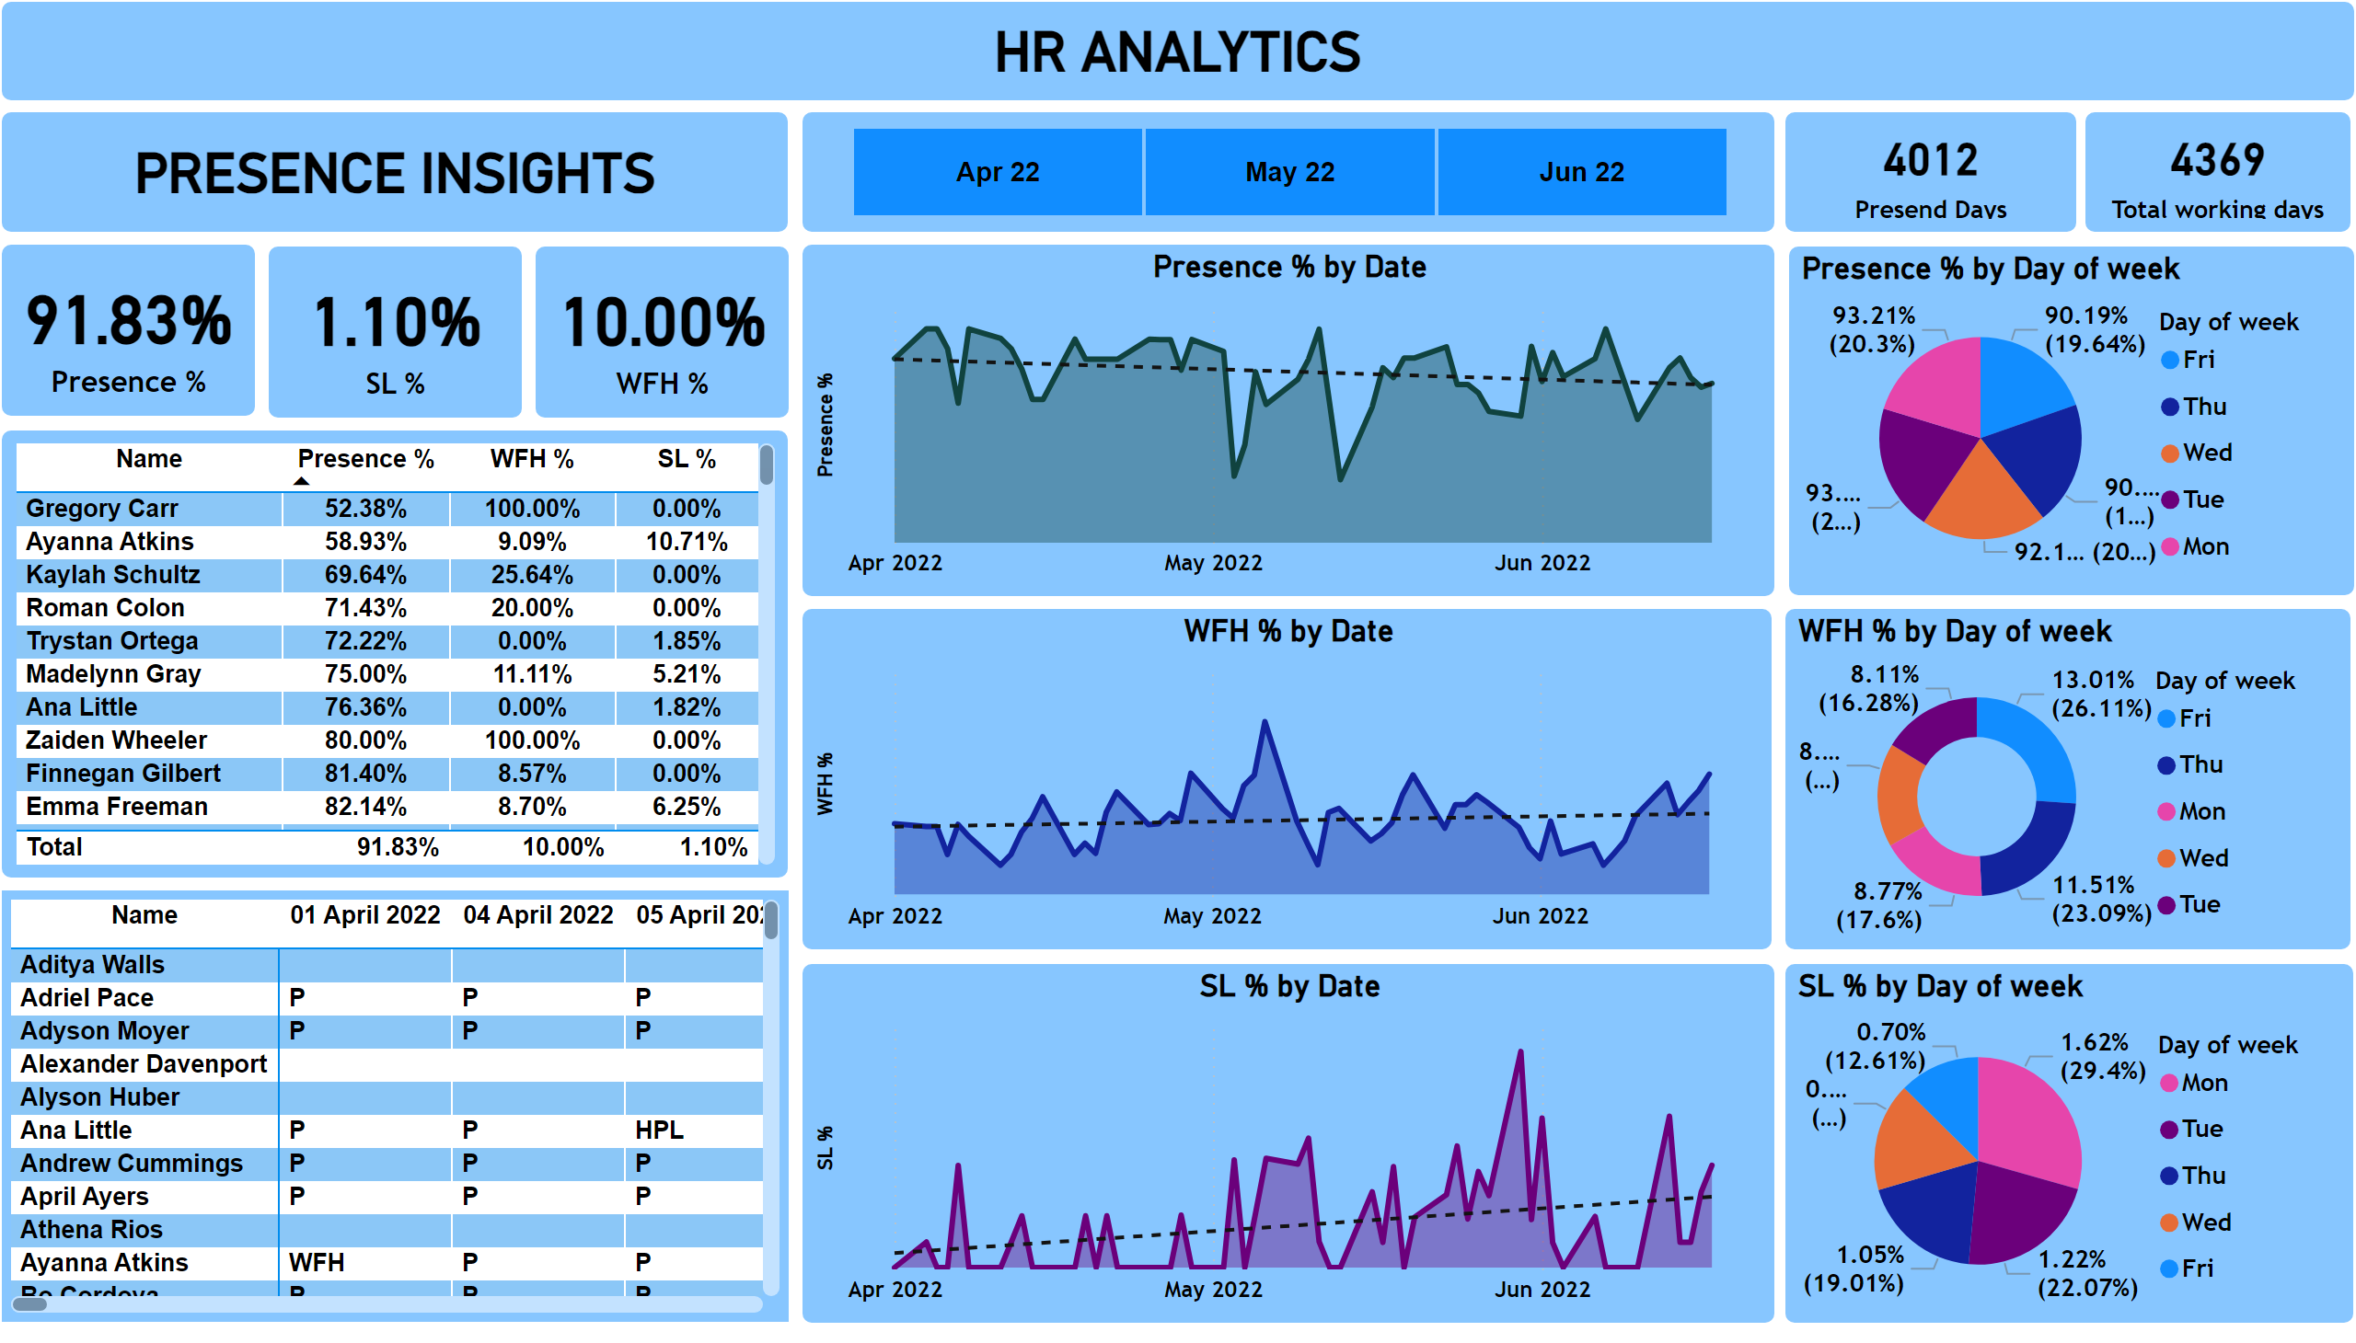
Page 1
Notes:
card
No alt text provided
card
No alt text provided
card
No alt text provided
slicer
No alt text provided
card
No alt text provided
card
No alt text provided
tableEx
No alt text provided
pivotTable
No alt text provided
areaChart
No alt text provided
areaChart
No alt text provided
areaChart
No alt text provided
pieChart
No alt text provided
donutChart
No alt text provided
pieChart
No alt text provided
shape
No alt text provided
shape
No alt text provided

